Slide 1
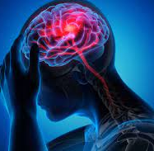

CAPSTONE PROJECT 2
SUBHAN QURESHI
AHMED BILAL
MUHAMMAD HUSSAIN
INSTRUCTOR:
MUHAMMAD HAMZA

Slide 2
BRAIN STROKE ANALYSIS
Background:
A stroke is a medical condition in which poor blood flow to the brain causes cell death.
According to the WHO, stroke is the 2nd leading cause of death globally, responsible for approximately 11% of total deaths. It’s a dangerous, which might greatly affect one’s living condition. Potential risk factors include age , hypertension, cholesterol ,Smoking , Diabetes and obesity.
The main risk factor for stroke is high blood pressure. Other risk factors include high blood cholesterol, tobacco smoking, obesity, diabetes mellitus, a previous TIA, end-stage kidney disease, and atrial fibrillation.

Slide 3
DATASET SUMMARY
This dataset is a recording of patient's body features and their stroke status. It contains 4891 observations with 11 attributes. It is used to predict whether a patient is likely to get stroke based on the input parameters like gender, age, various diseases, and smoking status. Each row in the data provides relevant information about the patient.

Slide 4
BELOW IS THE ATTRIBUTE INFORMATION:
gender: “Male”, “Female” or “Other”
age: age of the patient
hypertension: 0 if the patient doesn’t have hypertension, 1 if the patient has hypertension
heart_disease: 0 if the patient doesn’t have any heart diseases, 1 if the patient has a heart disease
ever_married: “No” or “Yes”
work_type: “children”, “Govt_jov”, “Never_worked”, “Private” or “Self-employed”
Residence_type: “Rural” or “Urban”
avg_glucose_level: average glucose level in blood
bmi: body mass index
smoking_status: “formerly smoked”, “never smoked”, “smokes” or “Unknown”*
stroke: 1 if the patient had a stroke or 0 if not
*Note: “Unknown” in smoking_status means that the information is unavailable for this patient.
link of the dataset: https://www.kaggle.com/datasets/jillanisofttech/brain-stroke-dataset

Slide 5
EXPLORATORY DATA ANALYSIS

Slide 6
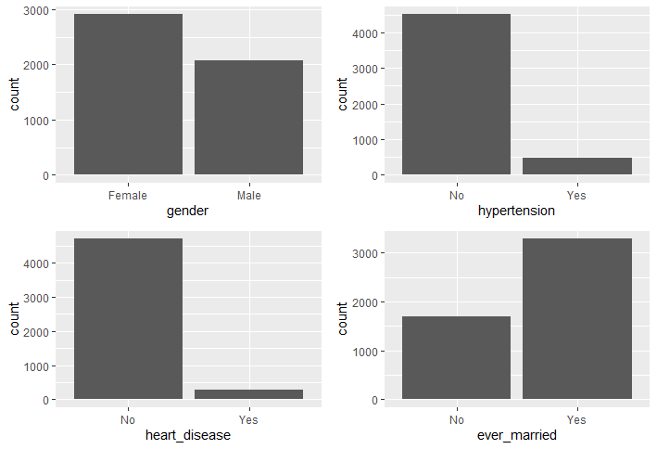
GENDER, HYPERTENSION, HEART DISEASES, AND MARITAL STATUS DISTRIBUTION

Slide 7
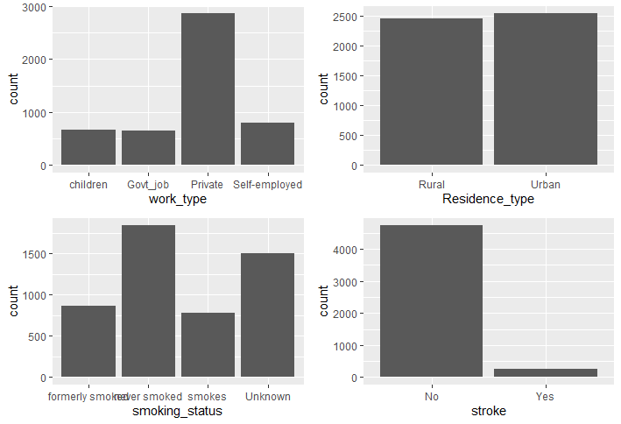
WORK TYPE, RESIDENCE TYPE, SMOKING STATUS, AND STROKE DISTRIBUTION

Slide 8
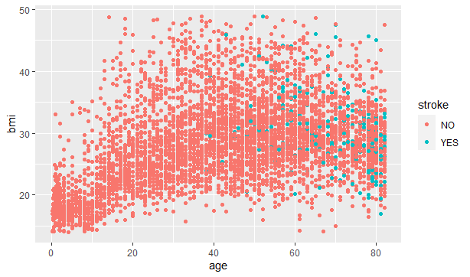
STROKE ON BMI AND AGE

Slide 9
TO MINIMIZE THE STROKE WITH RESPECT TO BMI
Healthy BMI – 19.9 - 24.9
Consume healthy diet
Workout should be done
Medical support

Slide 10
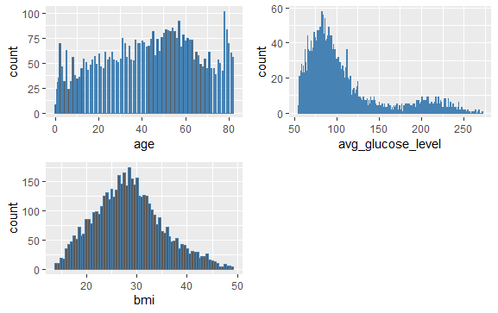
VISUALIZATION OF AGE, GLUCOSE LEVEL, AND BMI

Slide 11
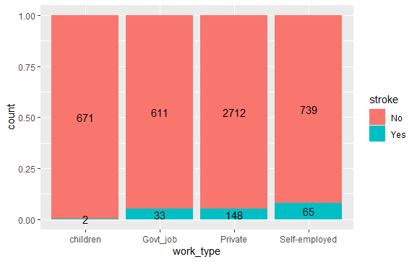
WORK TYPE VS STROKE

Slide 12
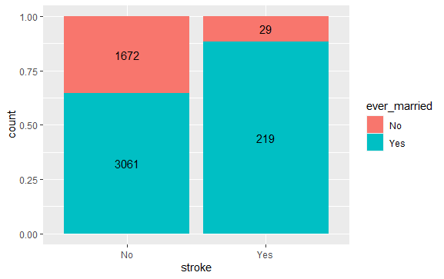
MARITAL STATUS VS STROKE

Slide 13
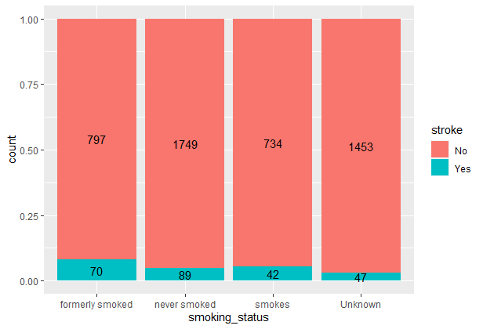
SMOKING STATUS VS STROKE

Slide 14
TO MINIMIZE THE STROKE WITH RESPECT TO SMOKING
Seek behavioral support
Use non-nicotine medications
Try alternative therapy

Slide 15
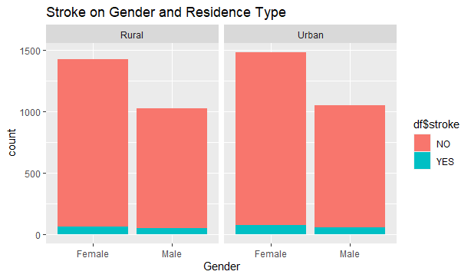
IS IT TRUE THAT THE STROKE RATE OF PEOPLE IN URBAN AREAS IS HIGHER AS COMPARED TO PEOPLE IN RURAL AREAS?
STROKE ON GENDER & RESIDENCE TYPE

Slide 16
HIGHER STROKE RATE IN URBAN AREA
Polluted environment
Lack of quality food
Taking much stress
Reduction in Physical activity

Slide 17
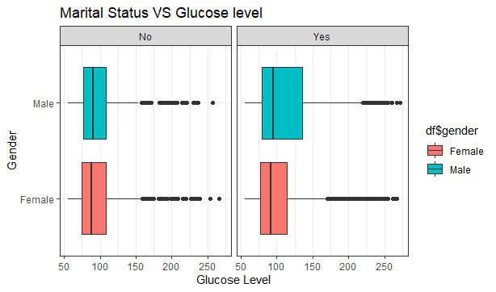
HAS MARRIED PEOPLE HIGHER GLUCOSE LEVEL THAN OTHER PEOPLE?

Slide 18
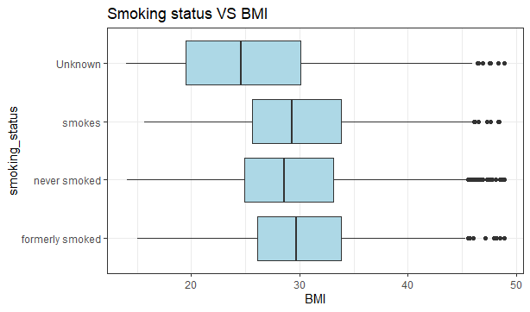
WHAT IS THE REASON BEHIND THE FACT THAT THE PEOPLE WHO USED TO SMOKE HAVE LOWER BMI LEVELS?

Slide 19
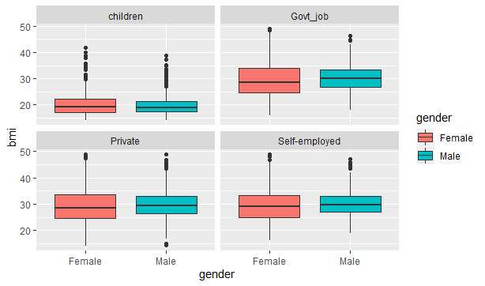
DOES THE WORK TYPE AFFECT BMI OR NOT?

Slide 20
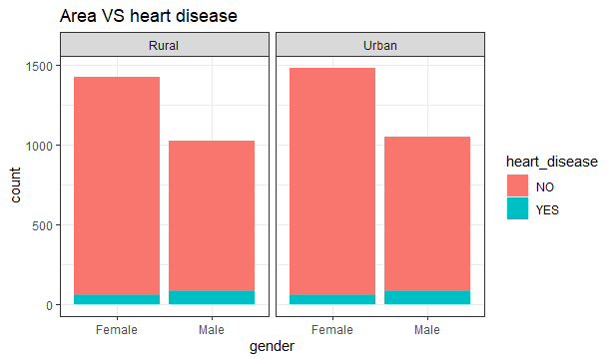
CAN WE SAY THAT PEOPLE WHO LIVE IN URBAN AREAS HAVE A HIGHER RATIO OF HEART DISEASE THAN OTHER PEOPLE? EVEN AFTER THE AVAILABILITY OF GOOD FACILITIES, WHY IS THIS SO?

Slide 21
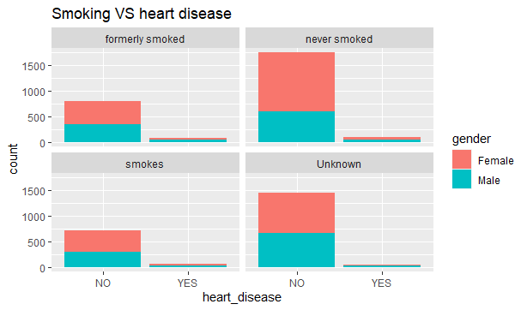
WHAT IS THE RATE OF HEART DISEASE IN THOSE WHO NEVER SMOKED THAN IN THOSE WHO MOSTLY SMOKE? WHY THE SMOKING INCREASES THE CHANCE OF HEART DISEASE?

Slide 22
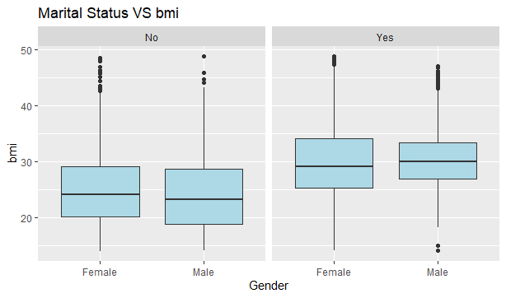
DO THE MEN WHO ARE MARRIED HAVE GREATER BMI THAN THOSE MEN WHO ARE NOT MARRIED?

Slide 23
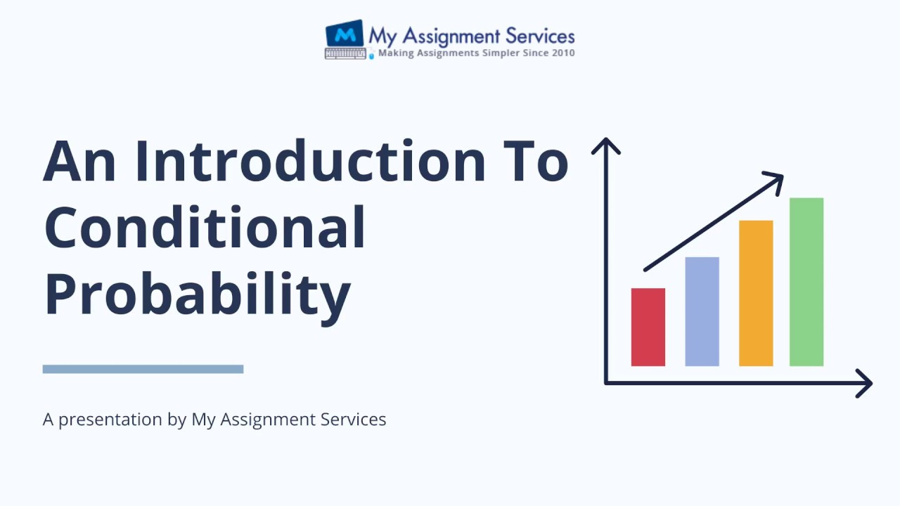
CONDITIONAL PROBABILITY

Slide 24
Stroke Probability of Randomly Selected person who is male
Stroke Probability of Randomly Selected person who is Female ?
 | Stroke
Gender | No | Yes
Female | 0.55551094 | 0.02810681
Male | 0.39469986 | 0.02168239

Slide 25
 | Stroke
Smoking Status | No | Yes
formerly smoked | 0.160008031 | 0.014053403
never smoked | 0.351134310 | 0.017867898
smokes | 0.147359968 | 0.008432042
Unknown | 0.291708492 | 0.009435856
If we select a person randomly who smokes formerly, then what is probability that he had a stroke?
If we select a person randomly who never smokes , then what is probability that he had a stroke?
If we select a person randomly who smokes , then what is probability that he had a stroke?

Slide 26
 | Stroke
Ever Married | No | Yes
No | 0.335675567 | 0.005822124
Yes | 0.614535234 | 0.043967075
If we select a married person randomly, then what is the probability that he had a stroke?
If we select a person randomly who never married, then what is the probability that he had a stroke?

Slide 27
If we select a person randomly who lives in Rural area, then what is probability that he had a stroke?
If we select a person randomly who lives in Urban area, then what is probability that he had a stroke?
 | Stroke
Residence type | No | Yes
Rural | 0.46898213 | 0.02268621
Urban | 0.48122867 | 0.02710299

Slide 28
THANK YOU!

